Slide 1
Title: Theoretical assessment design: Best practices in pre-registration nursing education.
Name: Gabieba Donough Doctoral Candidate (UWC, South Africa)
Supervisor: Professor F. Daniels (UWC, South Africa)
Co-supervisor: Dr K Mthimunye (UH, United Kingdom )

Slide 2
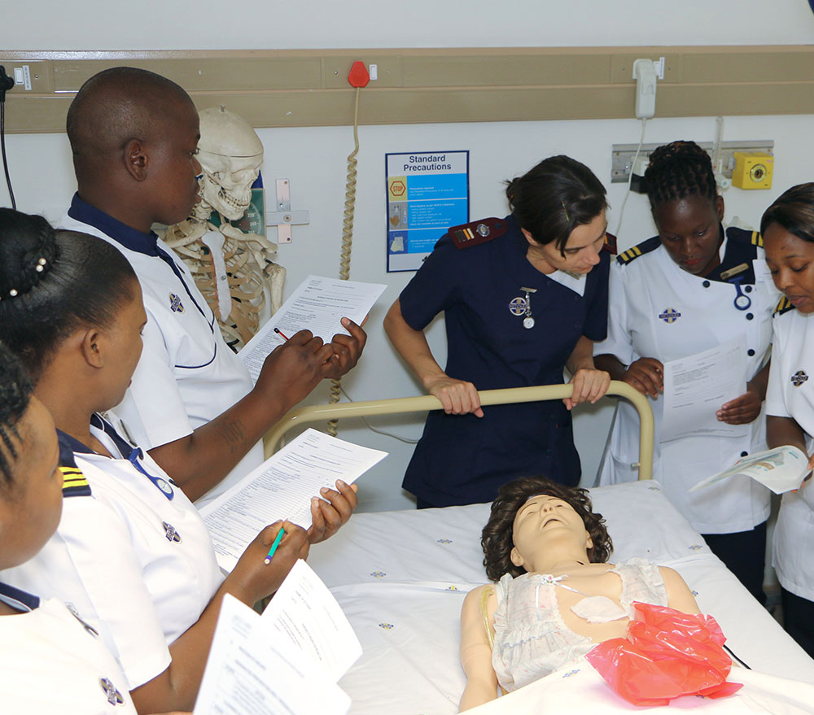
Introduction
Nursing education focuses on clinically-based nursing programmes (theoretical & clinical components).
To promote to the next level of study, students needs to be assessed
Assessments designed and good assessment practices

Slide 3
Background/ Literature Review
Operational definition | Assessment practices: It involves the policy, design and judgement around assessment (Bearman, et al, 2016). Focussed on the design of assessment practice
21st century
large class sizes
Increase in use of Technology
Assessment design
Notes:
Technology
Major impact of technology on teaching and learning globally
Everyone needs to be IT competent at least to a minimum level
Every year brings one new technology tool or more for HE
Negative – tremendous growth of plagiarism as its easy to copy from the internet
Online education
Largely because of globalization and technology, this is the growth area for the future
Blended learning

Slide 4
Frameworks
Biggs constructive alignment (1999)
Blooms Taxonomy (1965)

Slide 5
Methodology
Aim
Scoping review: aimed to establish best practices for theoretical assessment design in pre-registration nursing education.
Arksey and O'Malley's (2005) five-step framework:
identifying the initial research question,
identifying relevant studies,
study selection,
charting the data,
collating, summarizing and reporting the results.
Scoping Review
key question
strategy
search terms
Inclusion criteria
All types of studies that involved assessment practices in nursing education were considered.
Published qualitative and quantitative studies and reviews that were full-text and published in the English language were included.
Studies published between 2010- 2020 were selected.

Slide 6
Study selection process, data extraction and synthesis
PRISMA flow diagram by Moher et al., 2009

Slide 7
Findings and discussion
Twelve articles met the inclusion criteria. An iterative process was followed.
All the included studies were conducted at HEIs; one study was for a PhD Dissertation, one was a case study, and 10 studies were empirical research articles.
The studies were published between 2010 and 2018 and originated from 11 countries: Australia (n=1), Canada (n=1), Chile (n=1), Iran (n=1), the KSA (n=1), New Zealand (n=1), Norway (n=1), Spain (n=1), Sudan (n=1), the United Kingdom (n=1) and the United States of America (n=2).
The studies discussed assessment practices.
The findings revealed that various factors have a significant impact on theoretical assessment design in pre-registration nursing education.
Table 1: Assessments Practices
The use of taxonomy framework to align assessments | Bridging the theory-practice gap | Nurse educators’ workload

Slide 8
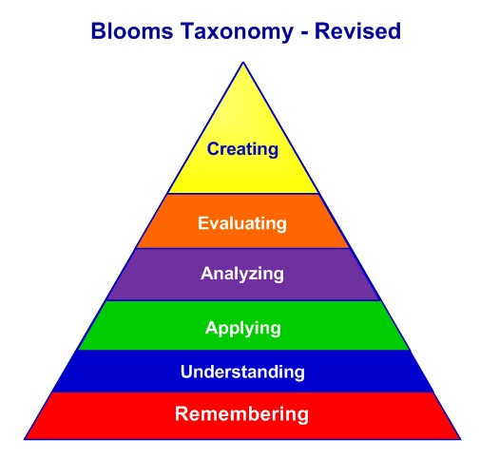
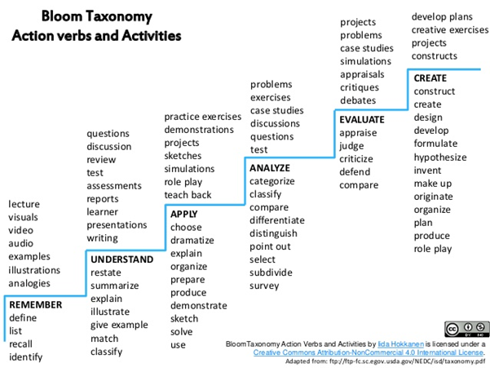
Applying the frameworks
Taxonomy level align with teaching methodology and assessment
T&L activities
Jigsaw Model
Traditional Model
Flip Model
Mentimeter: Muddiest Point monitoring technique
Think-Pair-Share
Outside class
In class
To monitor all students participate and understand
Outside
class
In class

Slide 9
Conclusion
Limitations of the Study
Recommendations for nursing education institutions
Recommendation for future research
The review can be used in higher education for institutional assessment policy development, educational practice and education research. It has the potential to contribute to the development of specific guidelines for designing quality assessments as well as support for higher education educators.
HEIs rely on assessment for student throughput and promotion purposes. To ensure quality student output and meet the global demand for quality professional nurses, educators must therefore use well-designed assessments. The review's findings suggest that HEIs can benefit from a quality assessment design by ensuring constructive assessment alignment and improving assessment design.
All HEI are encouraged to relook their current assessment practices.
The review concludes that learning and teaching must be in a constant state of reflection and change if higher education is to remain relevant to the benefit of the public.

Slide 10
References/ Bibliography:
Abdalla, M. E. (2013). Multiple Choice Questions Revisited: Improvement of Validity for Fair Tests. Gezira Journal of Health Sciences, 9(1), 1. http://journals.uofg.edu.sd/index.php/gjhs/article/view/399
Bearman, M., Dawson, P., Boud, D., Bennett, S., Hall, M., & Molloy, E. (2016). Support for assessment practice: developing the Assessment Design Decisions Framework. Teaching in Higher Education, 21(5), 545-556. https://doi.org/10.1080/13562517.2016.1160217
Biggs, J. (1996). Enhancing teaching through constructive alignment. Higher Education, 32(3), 347-364. https://link.springer.com/content/pdf/10.1007/BF00138871.pdf
Chinembiri, F. (2017). Evaluation Methods Used during the Assessment of an Academic Program at Micro-Level. Online Submission. https://eric.ed.gov/?id=ED573630
Fayilane, N. I. (2017). Analysing cognitive levels of final examination questions for the Diploma Nursing programme using the revised bloom’s taxonomy at a selected nursing college in Eastern Cape (Doctoral dissertation) https://ukzn-dspace.ukzn.ac.za/handle/10413/15678
Killingsworth, E., Kimble, L. P., & Sudia, T. (2015). What goes into a decision? How nursing faculty decide which best practices to use for classroom testing. Nursing Education Perspectives, 36(4), 220-225. doi: 10.5480/14-1492
Meyer, L. H., Davidson, S., McKenzie, L., Rees, M., Anderson, H., Fletcher, R., & Johnston, P. M. (2010). An investigation of tertiary assessment policy and practice: Alignment and contradictions. Higher Education Quarterly, 64(3), 331-350. https://doi.org/10.1111/j.1468-2273.2010.00459.x
Norton, L., Norton, B., & Shannon, L. (2013). Revitalising assessment design: what is holding new lecturers back? Higher Education, 66(2), 233-251. DOI 10.1007/s10734-012-9601-9
Oermann, M. H., De Gagne, J. C., & Phillips, B. C. (2017). Teaching in nursing and role of the educator: The complete guide to best practice in teaching, evaluation, and curriculum development. Springer Publishing Company.
Salminen, L., Stolt, M., Saarikoski, M., Suikkala, A., Vaartio, H., & Leino-Kilpi, H. (2010). Future challenges for nursing education–A European perspective. Nurse Education Today, 30(3), 233-238. https://doi.org/10.1016/j.nedt.2009.11.004

